Slide 1
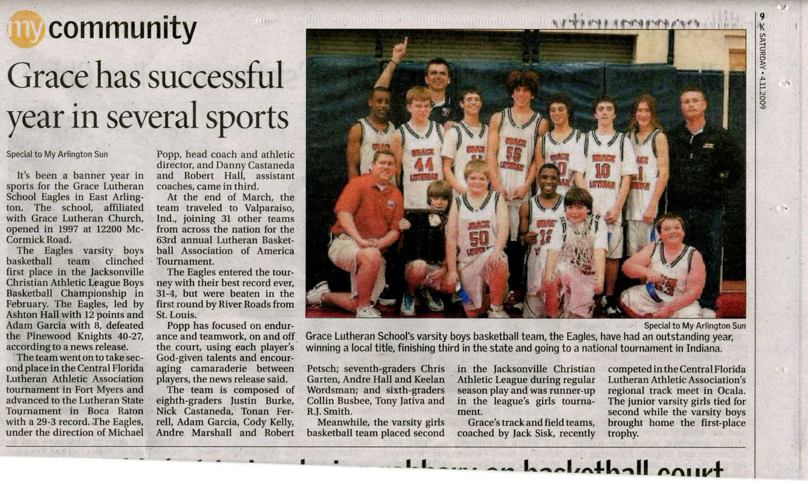
Building a Strong Community Presence
Julie Ann Peterson
Grace Lutheran School - Jacksonville, FL

Slide 2
Who’s In Our Community?

Slide 3
Potential Families Local media newspapers Television Radio stations Local Chambers/Council Local Businesses Community Pastors Day Care Directors Grandparents
Who’s In Our Community?

Slide 4
Consistent & Positive Feedback Prompt Follow Up Personal Care Plan Ahead School Advocates Marketing Materials
How do we build
these relationships?

Slide 5
Consistent & Positive Contact

Slide 6
Face-to-face visits
Invitations to events
Grandparents &
Special Friends e-newsletter
Thank you cards/letters

Slide 7
Prompt
Follow Up

Slide 8
Same day when possible
Never more than 24 hours
Multiple Touches
Phone call
E-mail
Hand written card
Have Teacher Connect

Slide 9
Personal Care

Slide 10
Use specific names
Parent and Student Mentors
Listen to what they like
Invite them to events that

Slide 11
Plan Ahead

Slide 12
Don’t wait until the last minute
Organization IS noticed!!!
Ask for help!!!
Keep track of what works…
And what doesn’t!

Slide 13
Utilize School Advocates

Slide 14
Recognize your Advocates:
Parents
Connect with potential families
Student Council Members
Create Ambassadors
Church Members
Great Volunteers
School Board Members

Slide 15
Marketing
Materials

Slide 16
Brochures
Pamphlets
Postcards
Websites
Scrapbooks
Coloring Books
Water Bottles
Gift Bags
Car Magnets
Tote Bags
Business Cards
Hats
Bracelets
Temporary Tattoos

Slide 17
If you can put your schools
Name
Logo
Phone Number
and/or
Website
on it…
IT CAN BE A MARKETING MATERIAL!

Slide 18
Local Media
Newspaper
Radio
Television
Local Chamber
Community Events

Slide 19
Newspaper
Get to know your editors!
Ask what you can do to make their jobs easier!
Send Follow up Thank You Notes!!!!!
Are they on-line?

Slide 21
Radio
Christian Stations
Secular Stations
Can be pricey
Worth Checking into
On-Line Event Calendar
Usually Free

Slide 22
Television
Local Stations
On-line Event Calendar
Reporters
Can they be a part of your event?
Community Hosted Events
Can you participate in their events?

Slide 23
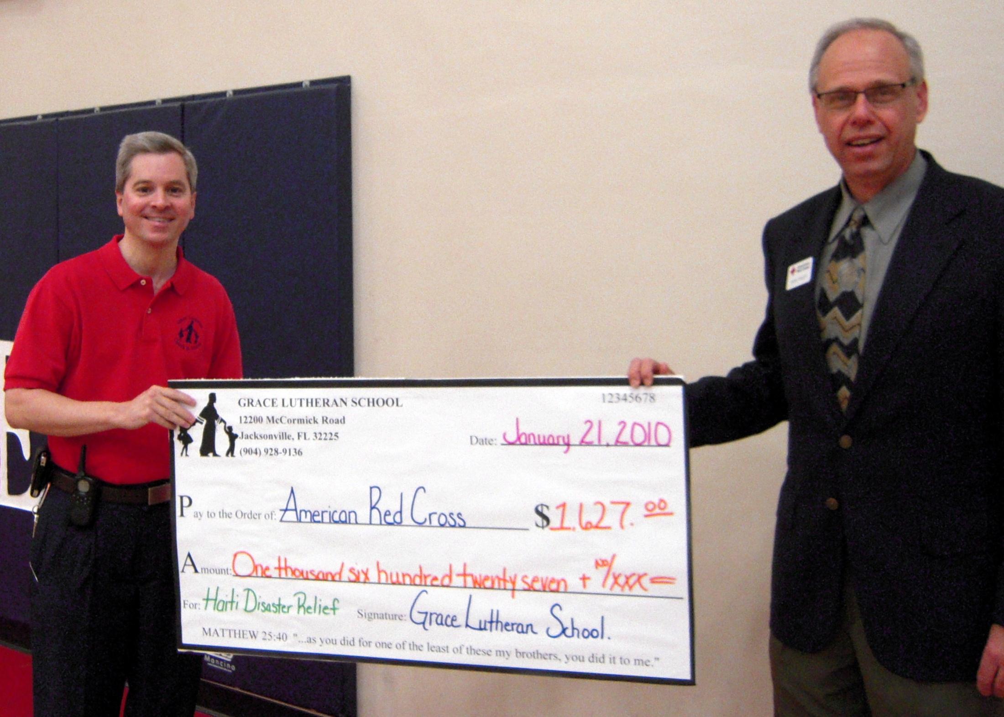

Slide 24
Local Chamber
Networking Opportunities
Donations for Auction
Programs for Students
Event Opportunities
Expos
Children’s Events
Marketing

Slide 25
Events
Private School Expo
Mall Events
Family Fun Events
Zoo
Parks
Concerts

Slide 26
USE YOUR IMAGINATION!!!

Slide 27
USE THE BLESSINGS GOD HAS GIVEN YOU!!!

Slide 28
Julie Ann Peterson Grace Lutheran School Jacksonville, FL (904) 928-9136 ext 11 julie_peterson@gracelutheraneagles.org

